Slide 1
Stock Room Tracker
Christopher Levesque
Co-mentor: Kayla Wilson

Slide 2
Objectives of the App
Be able to have each nurse in the hospital log in.
Each Nurse can view a list of their patients
Check out items in the stock room and associate them with a patient.
Reduce the amount of unaccounted for items.

Slide 3
Current Progress
Updated Storyboard
Database Schemas Finalized

Slide 4
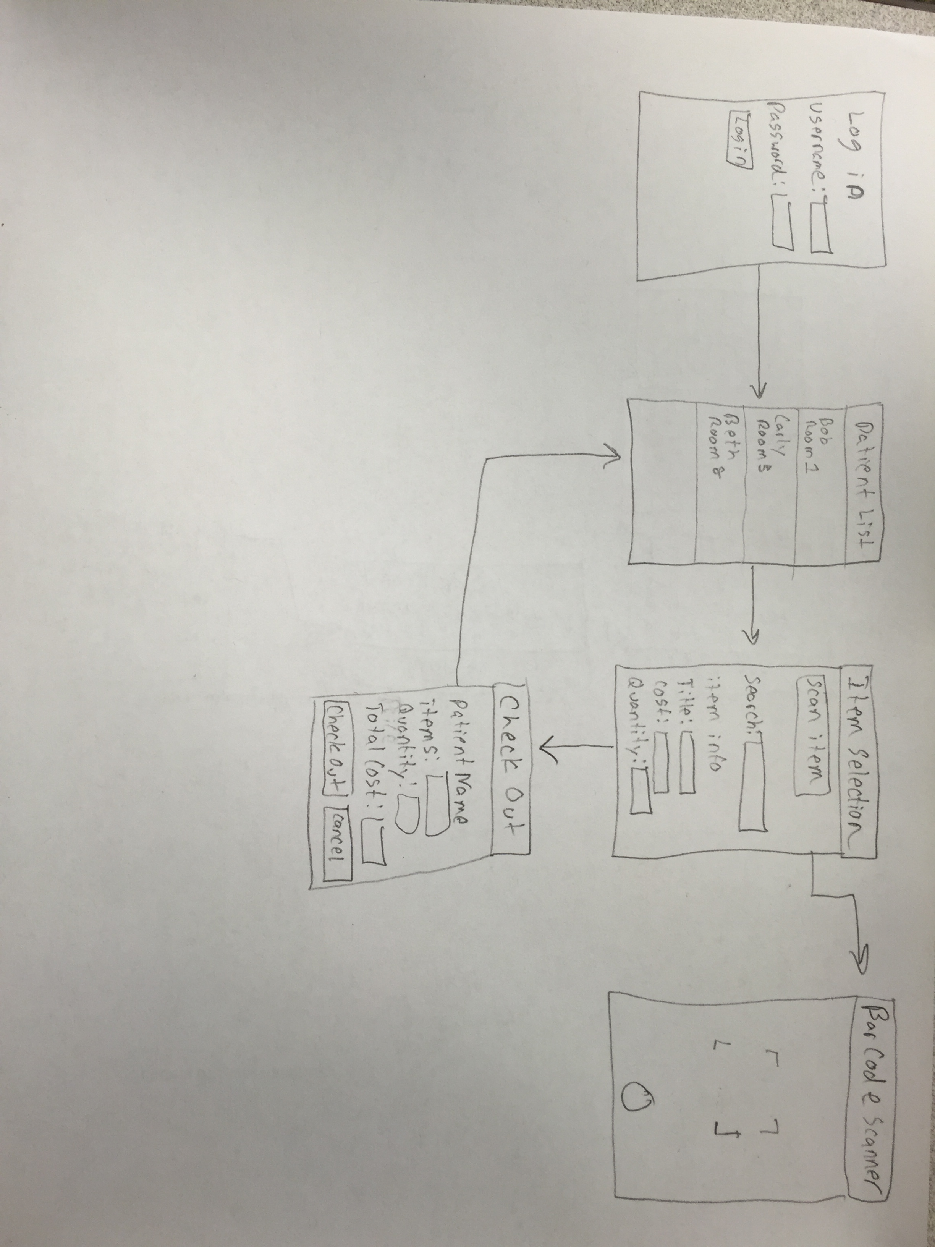
Storyboard

Slide 5
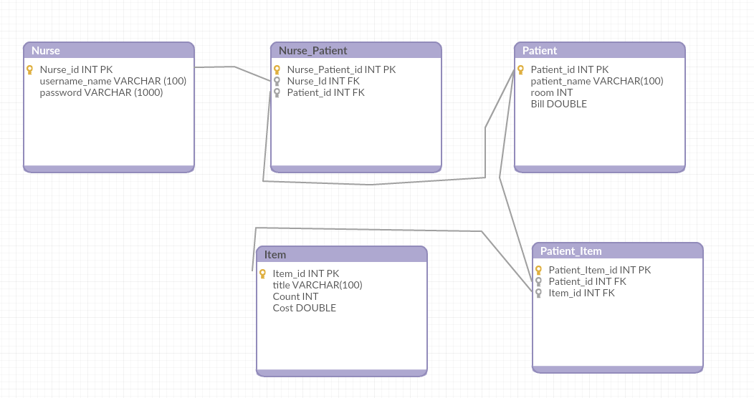
External Database

Slide 6
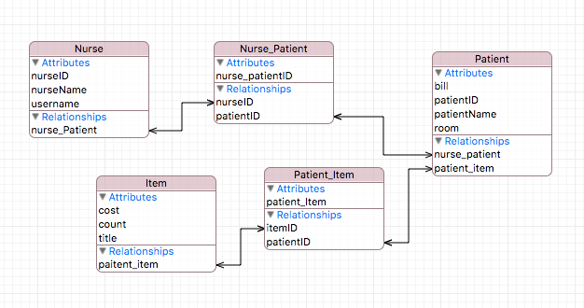
Internal Database

Slide 7
Future Plans
Build out the Storyboard in Xcode
Build Database on buffet.cs.clemson.edu
Get basic functionality of Internal Database working.
Saving patients in the table
Saving items to a patient.

Slide 8
Thank you
Mentor Kayla Wilson
Joey Costa for helping me get the Database Schema together.

